Slide 1

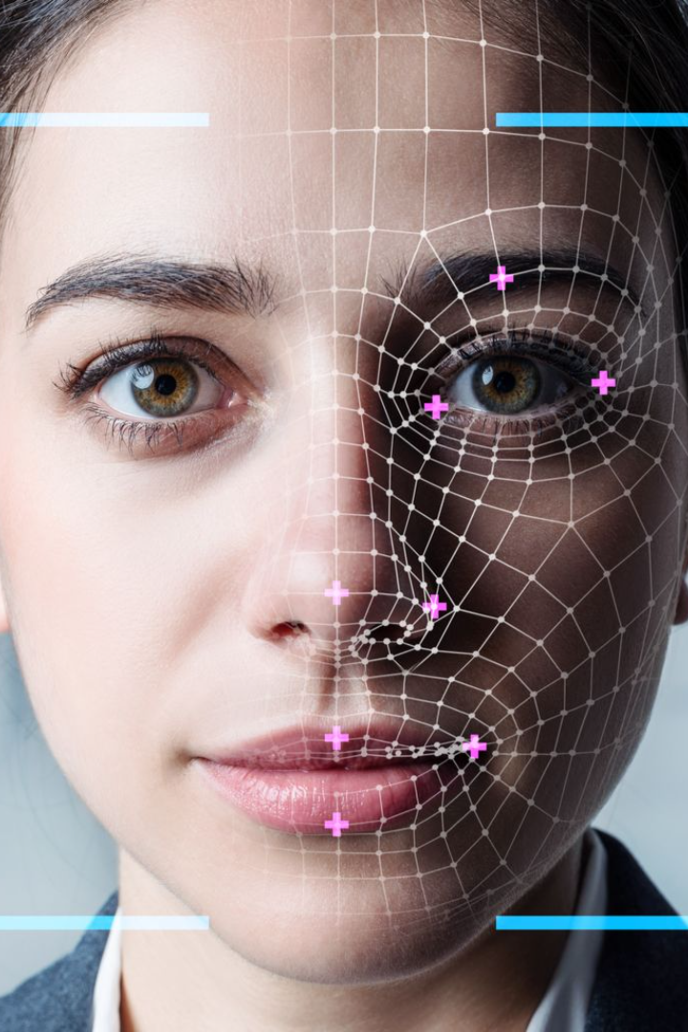
Automated Attendance System using Face Recognition
Computer Vision
CSE 429
4th of January 2024
An innovative web application that solves the problem of attendance tracking using advanced face recognition technology.

Slide 2
Agenda
1
Problem
The problem definition to our system
Objective
2
The objective of the system and how it improves efficiency
3
Data Preprocessing
Data preprocessing and collection techniques used in the system
Modeling
4
Modeling techniques used to develop the system
5
Web Application
We deployed our model as a user-friendly web application for easy access
Conclusion
6
Conclusion and future work

Slide 3

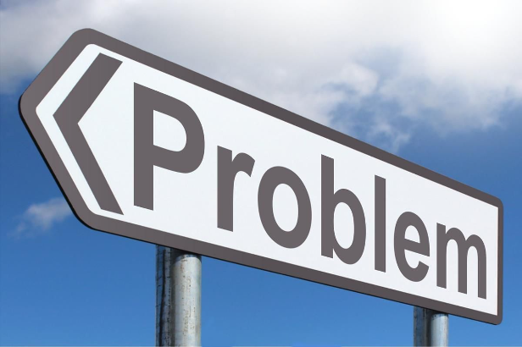
Problem Definition
Traditional attendance systems are time-consuming
and prone to errors.
The process of taking attendance manually
can lead to inaccuracies.
Manual attendance systems can be difficult to manage and track.

Slide 4
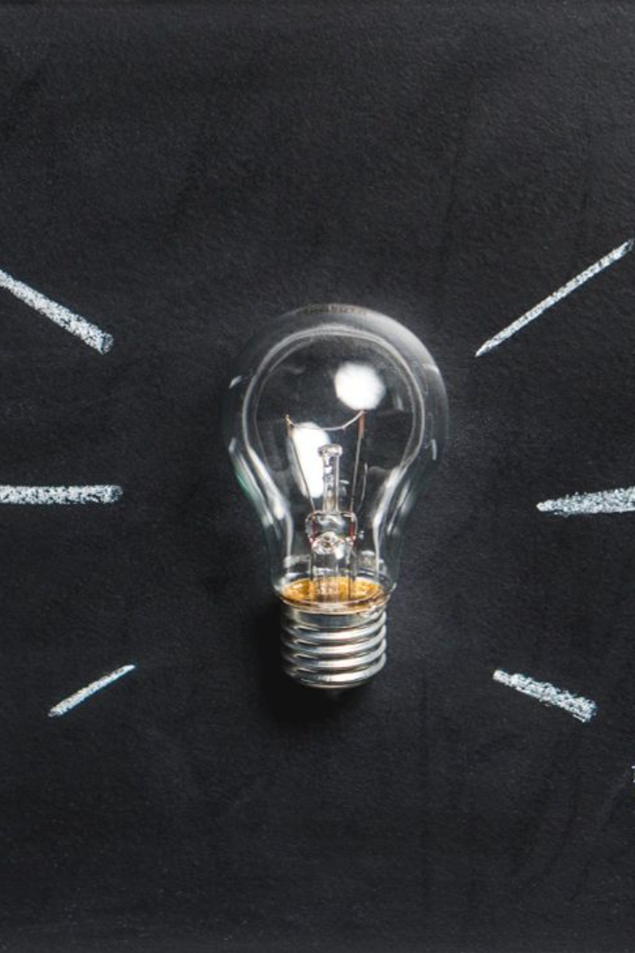
Objective
Our goal is to develop a fully automated attendance system that eliminates the need for manual tracking, improving efficiency and reducing administrative burden.

Slide 5

Data Collection and Preprocessing
1
Face Image Collection
2
Data Annotation
Gather a diverse dataset of facial images to train the model and improve recognition performance.
Manually label the collected data to provide ground truth information for training the face recognition model.
3
Video Preprocessing
Preprocess videos by dividing each into 5 frames
for further analysis and feature extraction.

Slide 6
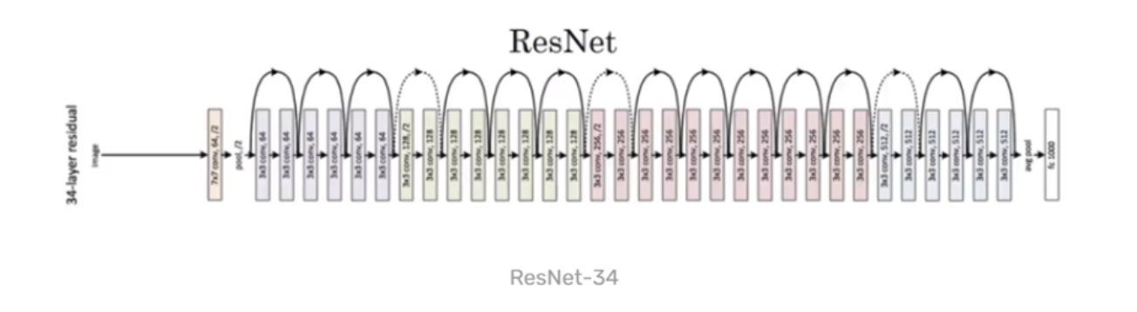
Model Architecture
A face recognition model based on a modified ResNet architecture
29 convolutional layers adapted from ResNet-34, with layer reduction and halved filter counts for performance optimization
Derived from the paper "Deep Residual Learning for Image Recognition
" by He, Zhang, Ren, and Sun

Slide 7
Modeling
1
Face Detection
2
Feature Extraction
3
Face Recognition
Detect faces in images or video frames to isolate the facial region for further processing using face detector model from dlib.
Extract unique facial features from the detected faces to create a reliable representation of each individual.
Match the extracted facial features with the pre-trained model to accurately identify individuals and record their attendance.

Slide 8
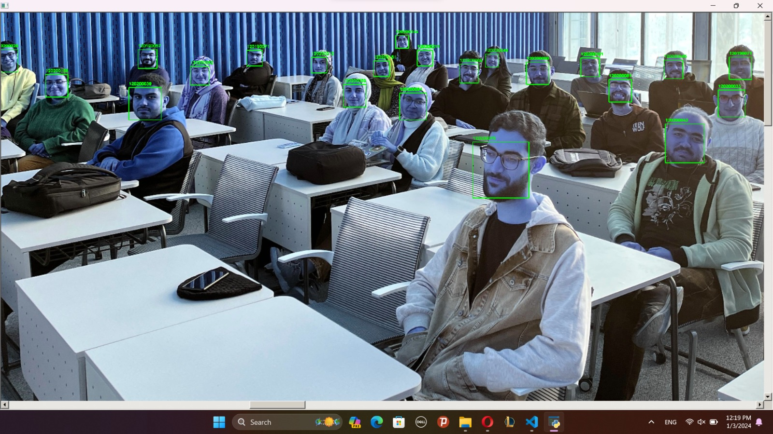
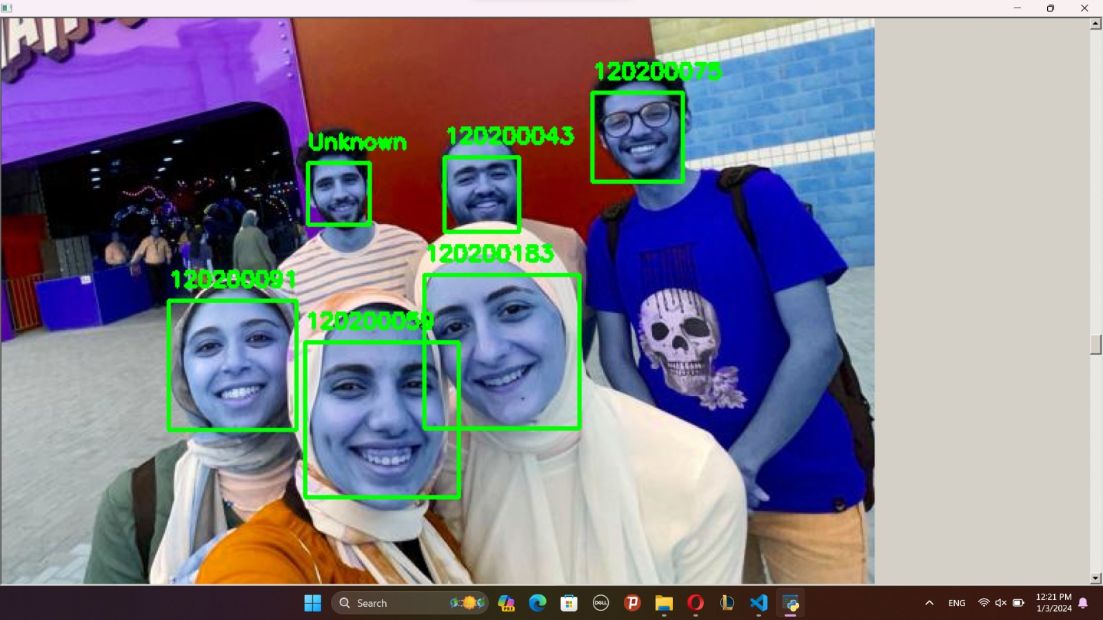
Model Result
Detected the no. of faces in the test image 22 as illustrated and recognizes 21 accurately.
When the person is not in the dataset , it recognized it as unknown

Slide 9
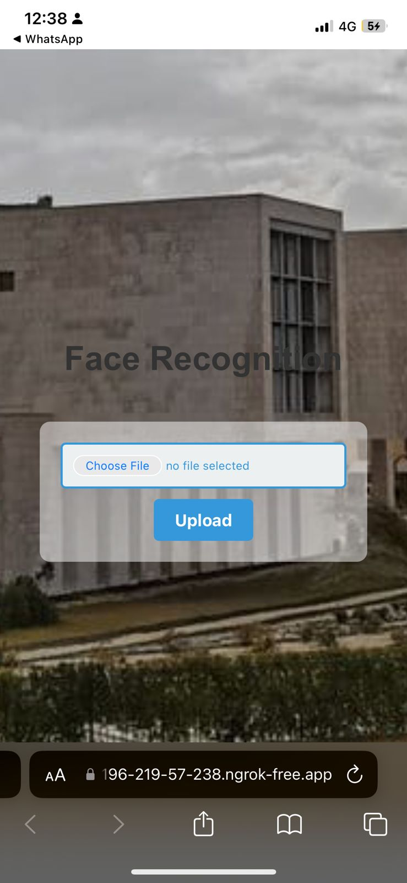
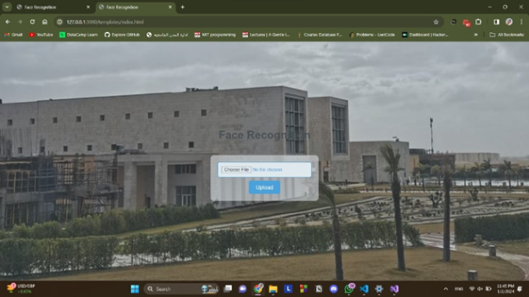
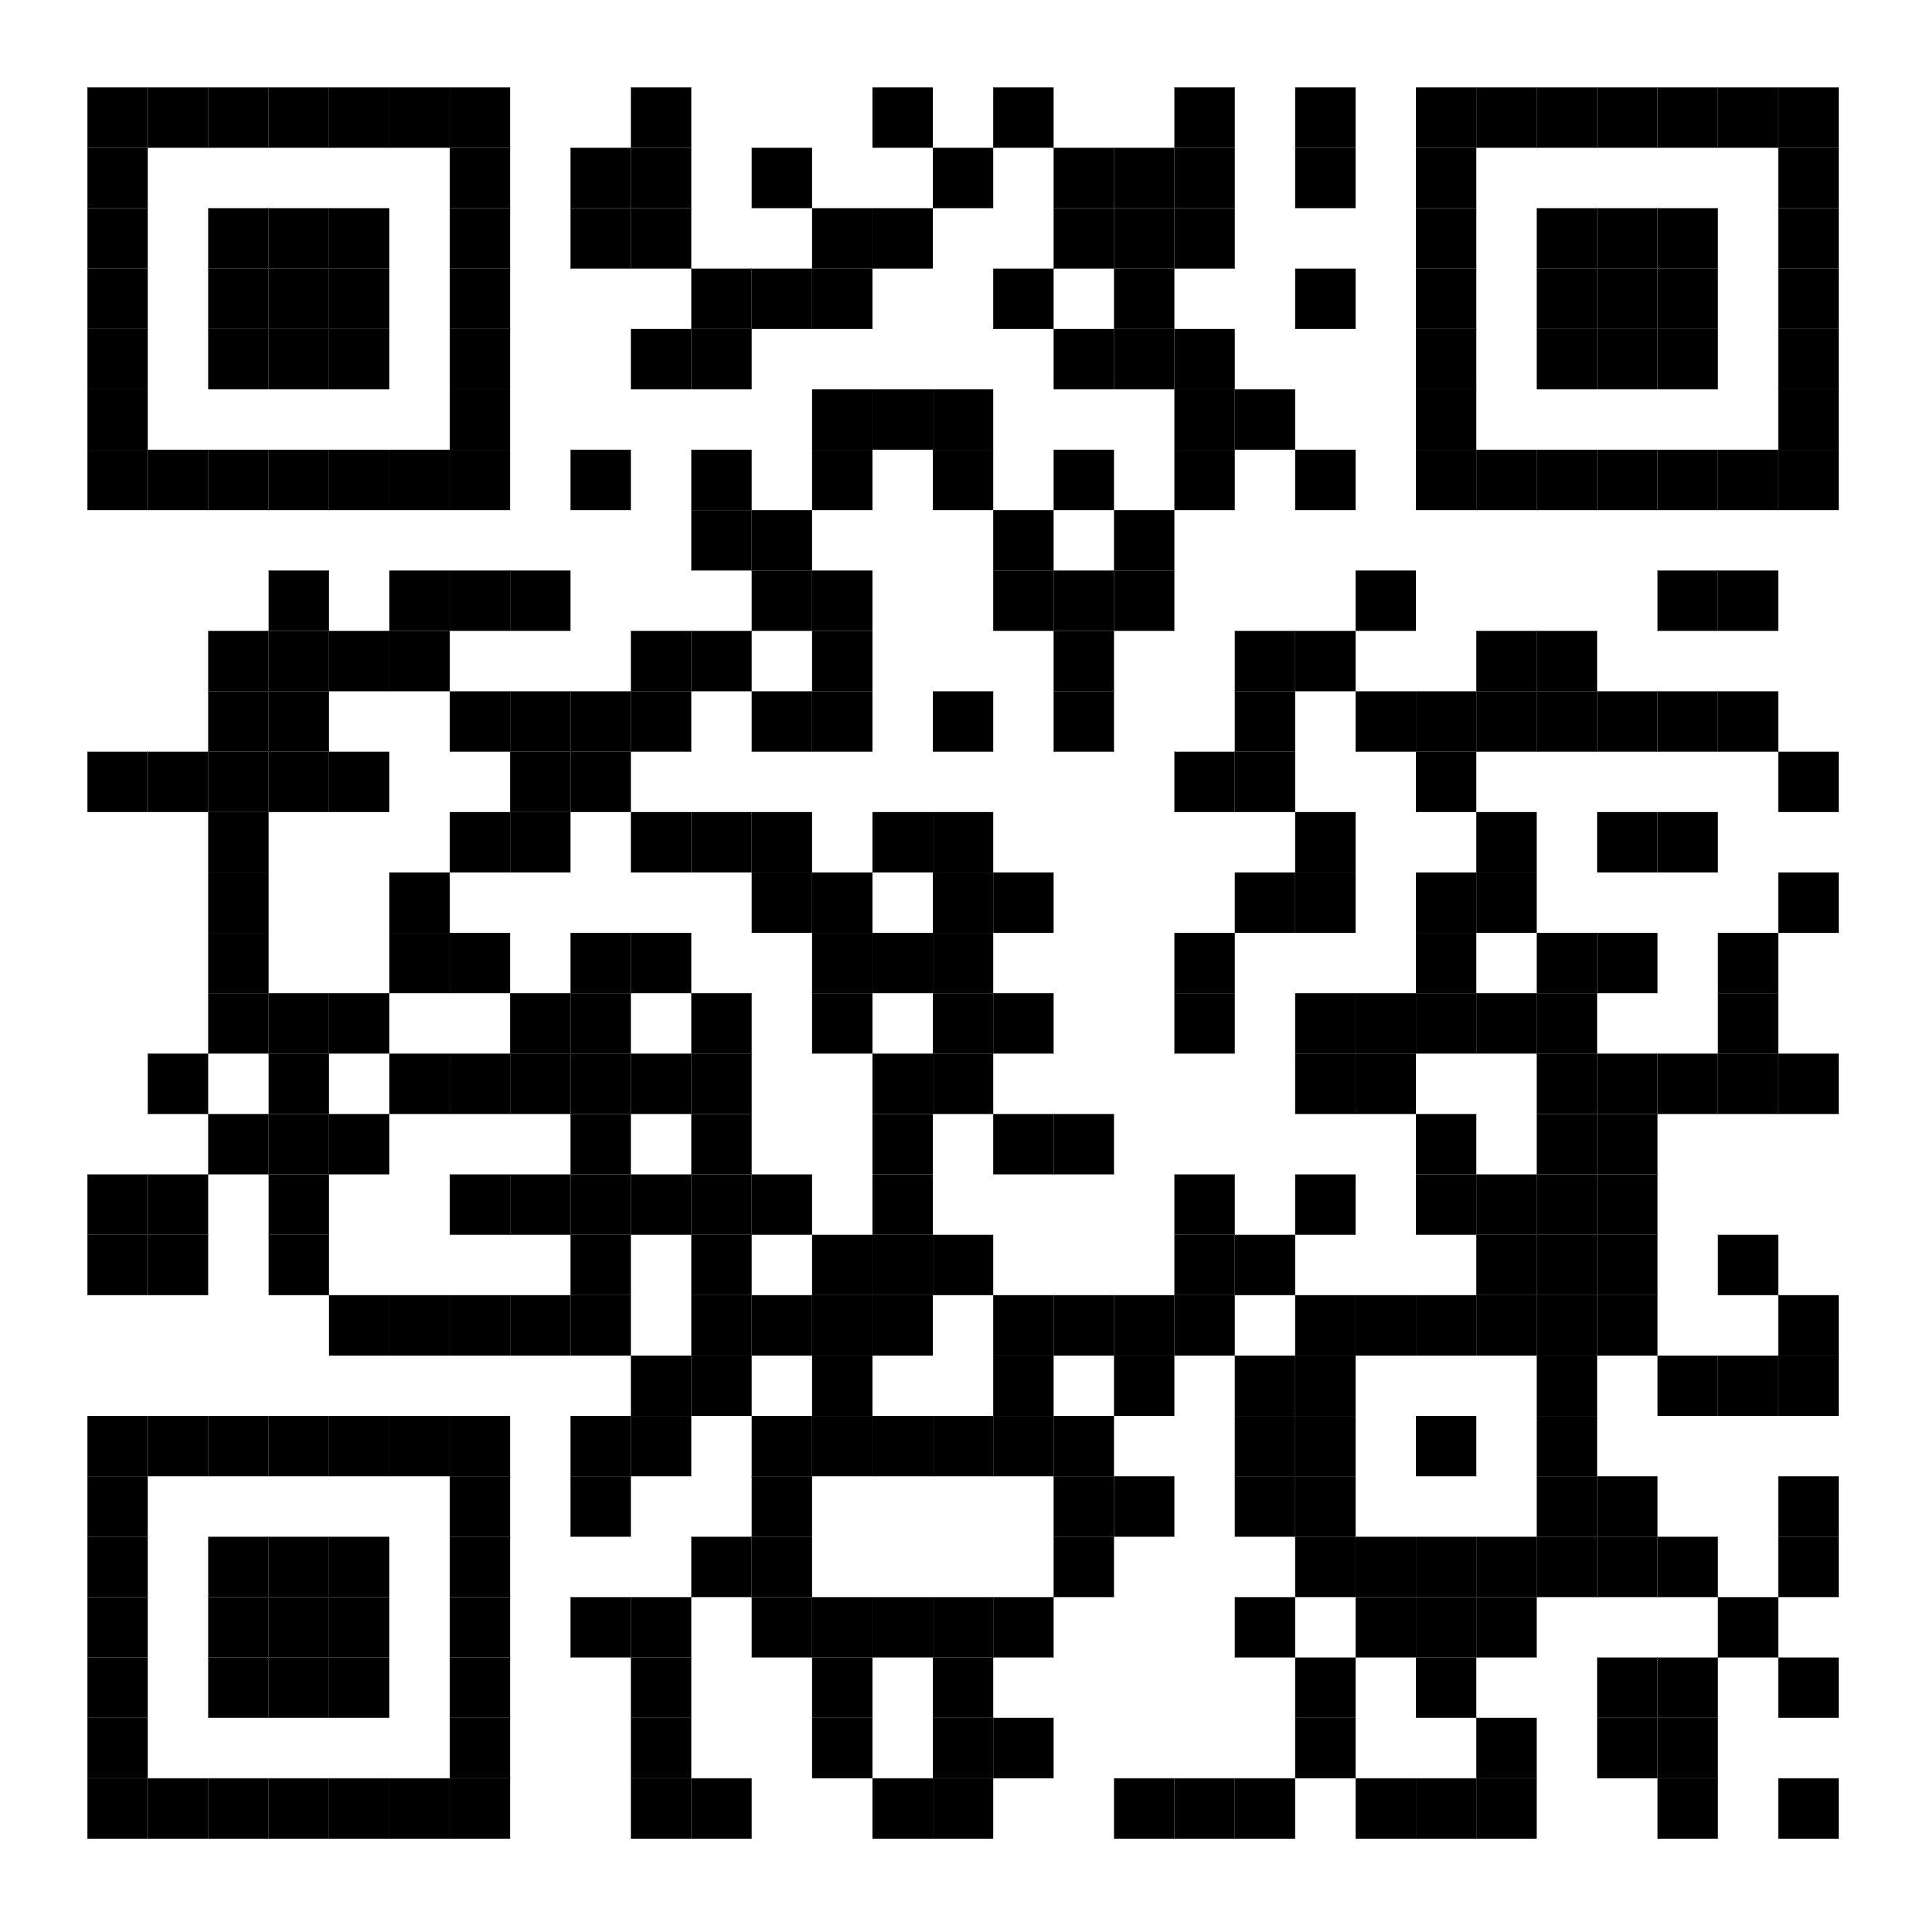
Web Application
1
Upload Images
2
Automatic Logging
3
User-Friendly Interface
The Flask web application allows users to upload images for face recognition.
The recognized individuals and timestamps are automatically logged in a Google Sheets spreadsheet.
The Flask app provides a simple and user-friendly interface for attendance tracking For both Mobile and Websites

Slide 10
Thank You!
Do you have any Questions ?

